Slide 1
Sort and Search
Sorting and Searching arrays to find data

Slide 2
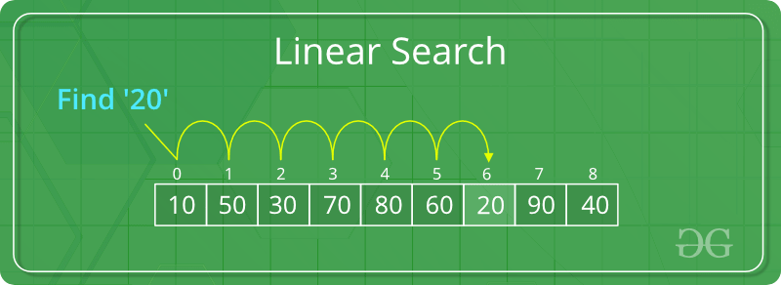
Linear Search
Previously we've looked at printing all values in a particular array.
If we wanted to find a value. We can use a linear search which is the easiest search you can perform.
It involves looking through an array in each index/element and checking if the element was found.
This is called a Linear search.

Slide 3
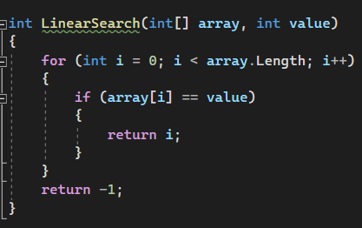
Linear Search

Slide 4
Sorting
In a linear search, it doesn’t matter how the data is ordered in the array. We can still find the data eventually.
However, generally sorting an array is helpful before searching.
Other algorithms require that the array be sorted before they can be searched using that algorithm.
There is an array method to sort an array:
Array.Sort();

Slide 5
Bubble Sort
A quick an easy way to sort an array is using a Bubble sort.
This sort works by swapping the values in the array from left to right if the value on the left is higher than the one on the right.
This bubbling "up" from left to right gives the sort algorithm its name.
The algorithm repeats this process for each element in the list until all elements are in the correct order.

Slide 6
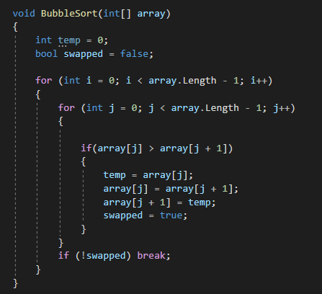
Bubble Sort

Slide 7
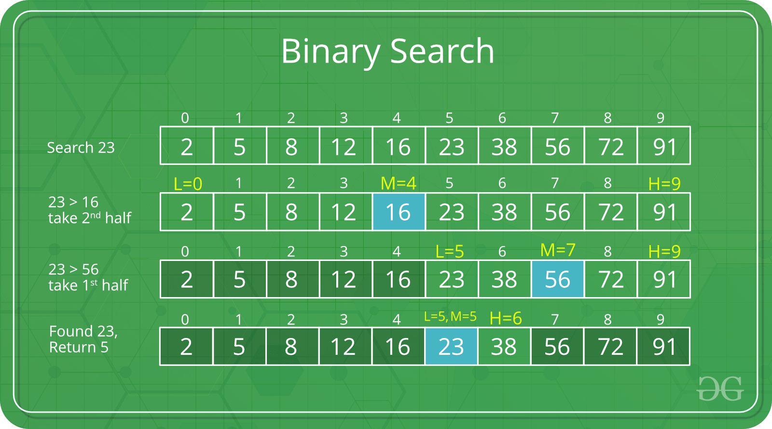
Binary Search
A binary search only works on a sorted array.
A binary search works by identifying if the value is less or greater than the middle value of the array.
If it is greater than the middle value, the lower portion of the array is removed from the search criteria.
If it is lower, the upper portion of the array is discarded.
Then the same process is repeated until the value is found.

Slide 8
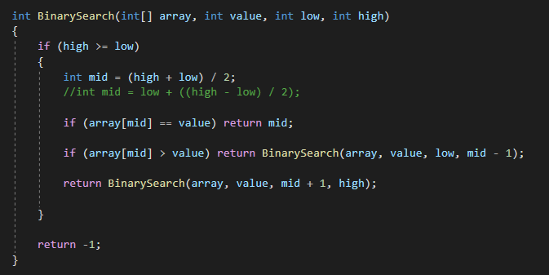
Binary Search

